Slide 1
More about Adf Faces

Slide 2
Using JavaScript in ADF Faces Rich Client Applications
ADF Faces is an Ajax-enabled rich JavaServer Faces component framework that uses JavaScript to render client-side components, implement rich component functionality, validate user input and convert user data input
The ADF Faces architecture is designed such that application developers don’t need to write JavaScript code themselves for most of the use cases they build. JavaScript in ADF Faces applications therefore should be used as an exception rather than the rule.

Slide 3
Using JavaScript in ADF Faces Rich Client Applications
Ajax-based partial refresh
Drag and drop
Client-side validation
Rich UI functionality
Lightweight dialogs

Slide 4
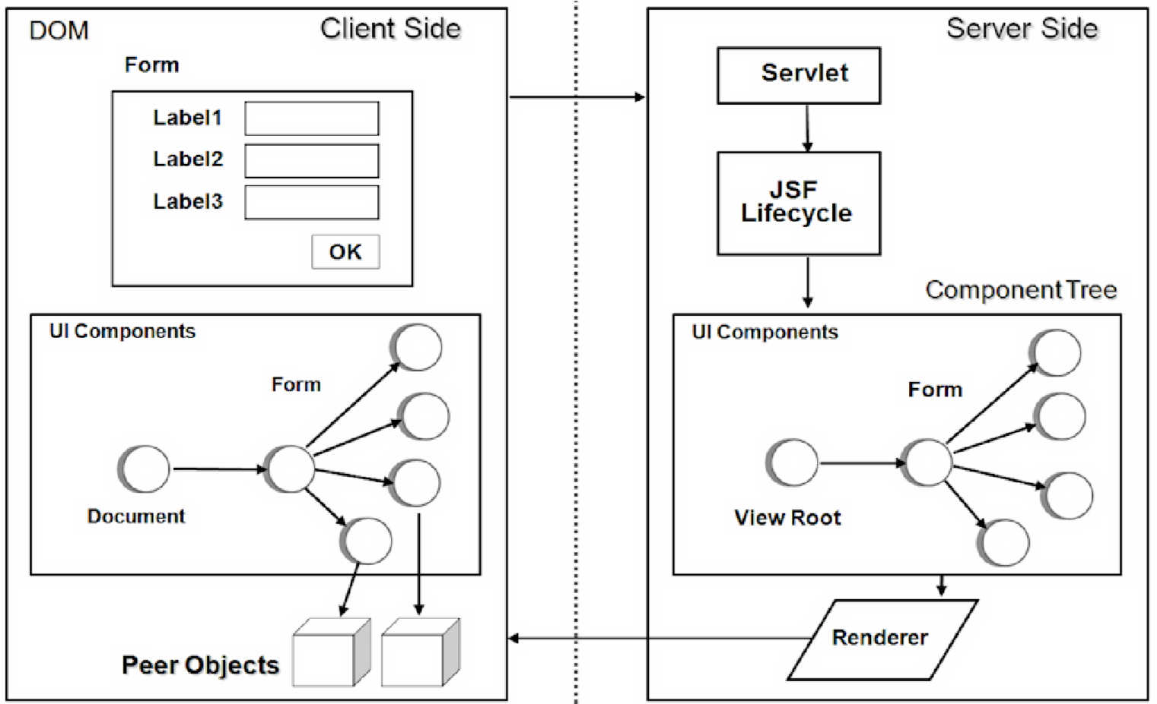
Using JavaScript in ADF Faces Rich Client Applications
ADF Faces client JavaScript object hierarchy compares to the serverside JavaServer Faces component hierarchy at runtime

Slide 5
ADF Faces JavaScript components
all objects at the minimum extend from AdfObject. Client-side ADF Faces UI component objects adhere to the naming convention used for their server-side peers, employing a prefix of "Adf" though.
In ADF Faces, two package structures are used: oracle.adf.view.js and oracle.adfinternal.view.js
Object scopes in ADF Faces, not to be confused with JavaServer Faces memory scopes, are implemented by the following naming conventions
public public : camel case pattern
private : start with _
protected : start with uppercase
package : start with double _

Slide 6
Adding JavaScript to on a page
To use JavaScript on an ADF Faces view, application developers either add JavaScript code to the page source or reference it in an external library file.
<af:resource type="javascript">
function customJsFunction(){ … }
</af:resource>

Slide 7
Creating client components
A component has an af:clientListener tag added. The af:clientListener component allows JavaScript function to listen for ADF Faces component events, like select or disclosure events, and browser DOM events like focus, mouse hover, mouse click, or keyboard events.
The component has its clientComponent property set to true.

Slide 8
Finding components on a page
findComponent – The AdfPage.PAGE.findComponent function searches a component by its client id.
findComponentByAbsoluteId – The recommended way to look up client-side ADF Faces components.
findComponentByAbsoluteLocator – For most components, the absolute locator used within .Only components (like tables) that stamp their children differ in that to access the stamped child component : "pc1:t1[stamp key].c1"

Slide 9
Listening for client events
To listen for a component event, developers use the af:clientListener tag located in the Oracle JDeveloper Component Palette's "Operation" category. The af:clientListener tag exposes two attributes
Method – The method attribute is the name of the JavaScript function to call in response to the component event. The JavaScript function needs to take a single argument for the event object that is passed in.
Type – The type attribute defines the event the client listener handles.

Slide 10
Listening for client events
How to prevent events from propagating to the server : When handling a client component event, application developers can prevent it from propagating to the server by a call to cancel() on the event object .
Using af:clientAttribute : The af:clientAttribute tag is specific to ADF Faces and is used to extend the properties set exposed by an ADF Faces client component.
<af:clientAttribute name="colname" value="#{tableRow.bindings.firstName.name}"/>
function copyValueToSelectedRows(evt) {
var txtField = evt.getSource();
var column = txtField.getProperty('colname');
}

Slide 11
Using JavaScript callback
function openPopup(popupId, compId){
return function(evt){
var popup = AdfPage.PAGE.findComponentByAbsoluteId(popupId);
var hints = {align:"end_before", alignId:compId };
popup.show(hints);
}
<af:inputText …>
<af:clientListener method=" openPopup('pc1:p1','txt1')" type=" contextMenu"/>
</af:inputText>

Slide 12
Invoking server-side Java from client-side JavaScript
A common requirement in Ajax is for the client to invoke server-side logic without performing page navigation. In ADF Faces, this can be implemented using the af:serverListener component
To invoke a server listener from JavaScript, application developers use the AdfCustomEvent JavaScript object's queue method. The method signature is:
public AdfCustomEvent(AdfUIComponent source, String type, Object params, Boolean immediate)
The "source" argument is the UI component that originates the custom server event
The "type" argument takes the name of the ServerListener component ( "MyCustomServerEvent" in this example).
The "params" argument is a JSON-encoded message array consisting of name:value pairs delimited by commas, e.g. {arg1:value1,arg2:value2, …}
The "immediate" flag determines whether the server call is handled during the JSF APPLY_REQUEST phase or during the InvokeApplication phase.

Slide 13
Invoking server-side Java from client-side JavaScript
<af:inputText id="it1" label="…">
<af:clientListener method="handleKeyUp" type="keyUp"/>
<af:serverListener type="MyCustomServerEvent" method="#{mybean.handleServerEvent}"/> </af:inputText>
function handleKeyUp (evt) {
var inputTextComponen = event.getSource();
AdfCustomEvent.queue(inputTextComponent, " MyCustomServerEvent ", {fvalue:component.getSubmittedValue()},false);
event.cancel(); }
public void handleServerEvent(ClientEvent ce){
String message = (String) ce.getParameters().get("fvalue"); }

Slide 14
Calling JavaScript from Java
To execute JavaScript from a managed bean, ADF Faces developers use the ExtendedRenderKitService class
StringBuilder script = new StringBuilder();
script.append(
"var popup = AdfPage.PAGE.findComponentByAbsoluteId('p1');"); script.append("if(popup != null){"); script.append("popup.show();"); script.append("}");
FacesContext fctx = FacesContext.getCurrentInstance();
ExtendedRenderKitService erks = Service.getRenderKitService(fctx, ExtendedRenderKitService.class);
erks.addScript(fctx, script.toString());

Slide 15
Keyboard event handling
<af:inputText id="inputText1" simple="true”>
<af:clientListener method="blockNumbers" type="keyDown"/>
</af:inputText>
function blockNumbers(evt){
var _keyCode = evt.getKeyCode();
var _filterField = evt.getCurrentTarget();
var _oldValue = _filterField.getValue();
//check for numbers
if (((_keyCode > 47) && (_keyCode < 58))|| ((_keyCode > 95) && (_keyCode < 106))){
_filterField.setValue(_oldValue);
evt.cancel();
}
}

Slide 16
About Using Different Output Modes
ADF Faces allows you to output your page in a simplified mode either for printing or for emailing. but instead of printing the page exactly as it is rendered in a web browser, you want to remove items that are not needed on a printed page, such as scroll bars and buttons. If a page is to be emailed, the page must be simplified so that email clients can correctly display it.
For displaying printable pages, ADF Faces offers the showPrintablePageBehavior tag that, when used in conjunction with a command component, allows users to view a simplified version of the page in their browser, which they can then print.

Slide 17
About Using Different Output Modes
The current output mode (email or printable) can be reached from AdfFacesContext
You can determine the current mode using AdfFacesContext.getOutputMode().
<af:activeImage source="/images/stockChart.gif" rendered="#{adfFacesContext.outputMode != "email"}"/>

Slide 18
Creating Emailable Pages
The ADF Faces framework provides you with automatic conversion of a JSF page so that it will render correctly in the Microsoft Outlook 2007 and Mozilla Thunderbird 2.0 email clients.
Insert a command component onto the page to be emailed.
In a managed bean, create an actionListener method or another service that appends org.apache.myfaces.trinidad.agent.email=true to the current URL and emails the page.

Slide 19
Skin for Emailable Page
@agent email {
af|table{
border:none
}
}
af|table::column-resize-indicator {
border-right: 2px dashed #979991;
}

